Slide 1

Project Presentation On “Malignant Comment Classifier”
Presented By: Ms. Pooja C

Slide 2
Agenda:
Overview.
Problem Statement.
Problem Understanding.
What is Malignant Comment Classifier?
Importance of Malignant Comment Classifier.
Exploratory data analysis.
Visualizations.
Analysis.
Model Building.
Hyper Parameter Tunning.
Saving the model and predictions for test dataset from saved best model.
Conclusion.

Slide 3
Overview:
In this particular presentation we will be looking on:
How to analyze the dataset of Malignant Comment Classifier.
What are the EDA steps in cleaning the dataset.
Overall analysis on the problem.
Model building from the cleaned dataset.
Predictions for test dataset from saved model.

Slide 4
Problem Statement:
The proliferation of social media enables people to express their opinions widely online. However, at the same time, this has resulted in the emergence of conflict and hate, making online environments uninviting for users. Although researchers have found that hate is a problem across multiple platforms, there is a lack of models for online hate detection. Online hate, described as abusive language, aggression, cyberbullying, hatefulness and many others has been identified as a major threat on online social media platforms. Social media platforms are the most prominent grounds for such toxic behaviour. There has been a remarkable increase in the cases of cyberbullying and trolls on various social media platforms. Many celebrities and influences are facing backlashes from people and have to come across hateful and offensive comments. This can take a toll on anyone and affect them mentally leading to depression, mental illness, self-hatred and suicidal thoughts. Internet comments are bastions of hatred and vitriol. While online anonymity has provided a new outlet for aggression and hate speech, machine learning can be used to fight it. The problem we sought to solve was the tagging of internet comments that are aggressive towards other users. This means that insults to third parties such as celebrities will be tagged as unoffensive, but “u are an idiot” is clearly offensive. Our goal is to build a prototype of online hate and abuse comment classifier which can used to classify hate and offensive comments so that it can be controlled and restricted from spreading hatred and cyberbullying.

Slide 5
Problem Understanding:
In the past few years its seen that the cases related to social media hatred have increased exponentially. The social media is turning into a dark venomous pit for people now a days. Online hate is the result of difference in opinion, race, religion, occupation, nationality etc. In social media the people spreading or involved in such kind of activities uses filthy languages, aggression, images etc. to offend and gravely hurt the person on the other side. This is one of the major concerns now. The result of such activities can be dangerous. It gives mental trauma to the victims making their lives miserable. People who are not well aware of mental health online hate or cyber bullying become life threatening for them. Such cases are also at rise. It is also taking its toll on religions. Each and every day we can see an incident of fighting between people of different communities or religions due to offensive social media posts. Online hate, described as abusive language, aggression, cyberbullying, hatefulness, insults, personal attacks, provocation, racism, sexism, threats, or toxicity has been identified as a major threat on online social media platforms. These kinds of activities must be checked for a better future.

Slide 6

What is Malignant Comment?
Malignant Comment Classification: A Classification model designed to detect the type of toxic comments to detect and prevent online bullying.

Slide 7
Importance of Malignant Comment Classifier.
Nowadays users leave numerous comments on different social networks, news portals, and forums. Some of the comments are toxic or abusive. Due to numbers of comments, it is unfeasible to manually moderate them, so most of the systems use some kind of automatic discovery of toxicity using machine learning models. In this work, we performed a systematic review of the state-of-the-art in toxic comment classification using machine learning methods. First, we have investigated when and where the papers were published and their maturity level. In our analysis of every primary study we investigated: data set used, evaluation metric, used machine learning methods, classes of toxicity, and comment language.
Internet comments are bastions of hatred and vitriol. While online anonymity has provided a new outlet for aggression and hate speech, machine learning can be used to fight it. The problem we sought to solve was the tagging of internet comments that are aggressive towards other users. This means that insults to third parties such as celebrities will be tagged as unoffensive, but “u are an idiot” is clearly offensive. Our goal is to build a prototype of online hate and abuse comment classifier which can used to classify hate and offensive comments so that it can be controlled and restricted from spreading hatred and cyber bullying.

Slide 8
Exploratory Data Analysis:
As a first step I have imported required libraries and I have imported the dataset which was in csv format.
Cleaned the data from junk values. Replace multiple spaces with single space So that it will be easy to classify it.
I am creating a function for feature engineering and making three different columns using comment_text column Length: indicating the length of the text. Exclamation: indicates whether ‘!’ is present in the text or not. Question: indicates whether ‘?’ is present in the text or not.
By observing these comments we can say that we need to do lot of text processing as there are many words which are not important for prediction, as well as numbers and other stuff.

Slide 9
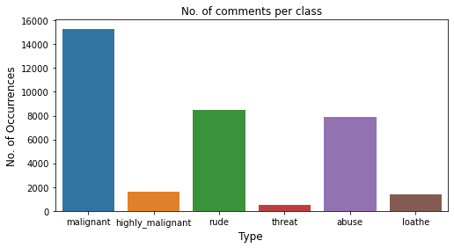
Visualization:
The above figure represents count plot for all our labels. Looking at this plot we can conclude that more number of comments has been labelled as malignant compared to others. Very less number of comments has been labelled as threat.

Slide 10
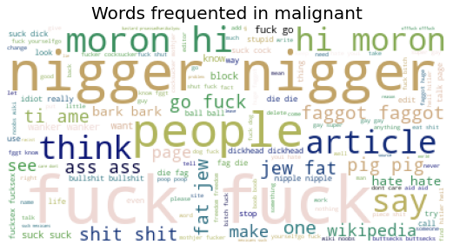
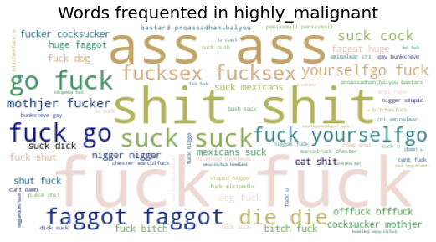
Visualization:
The above both figures are representing the word occurrence in case of malignant and highly malignant comments respectively.

Slide 11
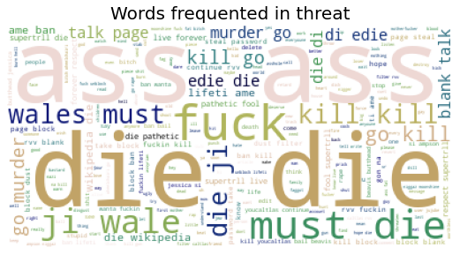
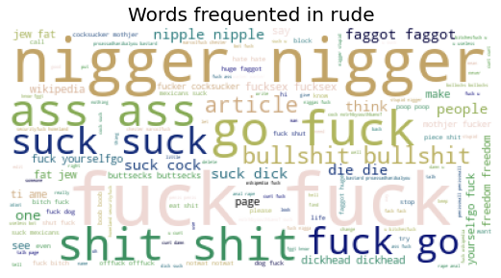
Vizualization:
The above both figures are representing the word occurrence in case of threat and highly rude comments respectively.

Slide 12
Analysis:
This project is more about exploration, feature engineering and classification that can be done on this data. Since the data set is huge and includes many categories of comments, we can do good amount of data exploration and derive some interesting features using the comments text column available.
Just make the comments more appropriate so that we’ll get less word to process and get more accuracy.
Removed extra spaces, converted email address into email keyword, likely wise phone number etc. Tried to make Comments small and more appropriate as much as it was possible.

Slide 13
Model Building:
In this nlp based project we need to predict multiple targets which are binary. I have converted the text into vectors using TFIDF vectorizer and separated our feature and labels then build the model using One Vs Rest Classifier. Among all the algorithms which I have used for this purpose I have chosen LinearSVC as best suitable algorithm for our final model as it is performing well compared to other algorithms while evaluating with different metrics I have used following algorithms and evaluated them
LinearSVC
LogisticRegression
MultinomialNB
LightGBMClassifier
SGDClassifier
From all of these above models LinearSVC was giving me good performance.

Slide 14
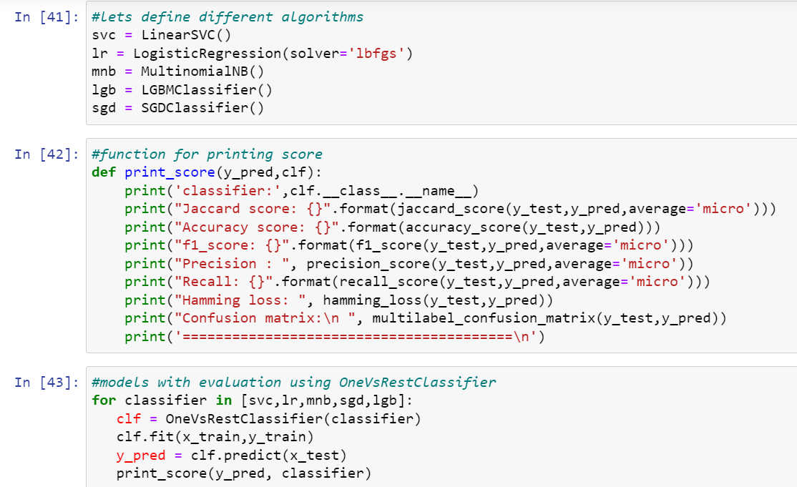
I got Linear SVC as the best model. So I have to do hyper parameter tunnig for this best model.

Slide 15
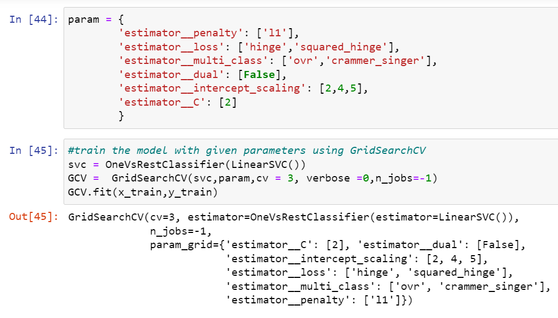
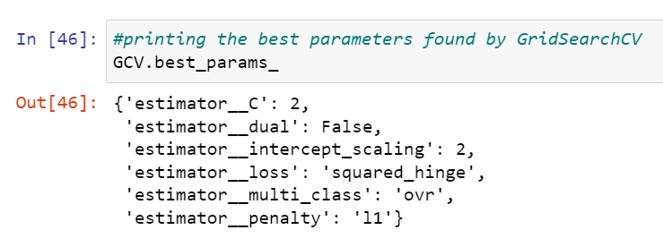
Hyper Parameter Tunning:

Slide 16
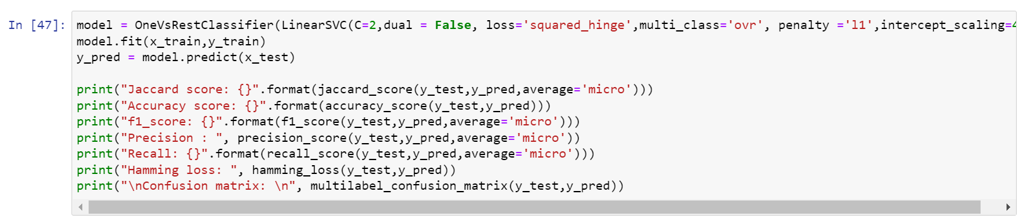
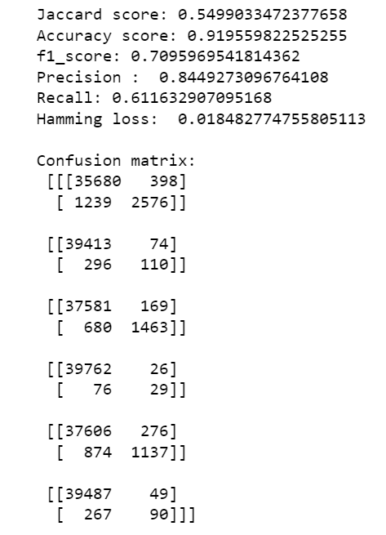
Hyper Parameter Tunning:
And after doing hyperparameter tuning I got above parameters as best suitable parameters for our final model.
I have tested my final model using these parameters and got better results compared to earlier results for my final model.

Slide 17
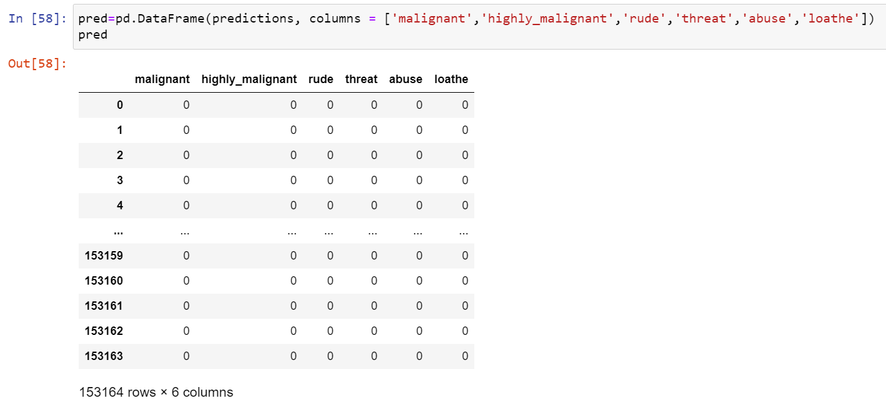
Saving the model and predictions for test dataset using saved model:
I have saved my best model using .pkl as follows.
Now after saving the best model, loading my saved model and predicting.
I have predicted the malignance using saved model, and the predictions look good.

Slide 18
Conclusion:
In this project report, we have used machine learning algorithms to predict the Malignant Comment Classifier. We have mentioned the step by step procedure to analyze the dataset and finding the correlation between the features.
Thus we can select the features which are correlated to each other and are independent in nature. The power of visualization has helped us in understanding the data by graphical representation it has made me to understand what data is trying to say.
Data cleaning is one of the most important steps to remove unrealistic values and unnecessary stop words.
These feature set were then given as an input to five algorithms and a hyper parameter tunning was done to the best model and the accuracy has been improved. Hence we calculated the performance of each model using different performance metrics and compared them based on these metrics.
Then we have also saved the best model and predicted the label.

Slide 19


